Slide 1
FOV WEEK OF 10/9- 10/13
UNIT VOCABULARY:
Delta, shadoof, papyrus, hieroglyphics
EXCEPTIONAL 18
Support, explain

Slide 2
FOV MONDAY october 9th
1. Around 2600 b.c., Egyptian civilization entered the period know as _______.
Middle kingdom
New kingdom
Old kingdom
Magic kingdom
2. To “support” your opinion means to ______.
Back up with details
Leave out details
Draw a conclusion
Outline

Slide 3
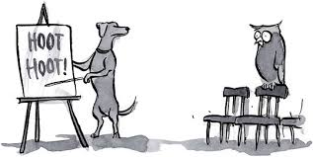
FOV tuesDAY october 10th
Egyptians were loyal to the pharaoh because they believed he was the son of _____, the Egyptian sun god.
cleopatra
Seth
Isis
Re (RAY)
2. The term “explain” means to _______.
Support
Tell how
Draw a conclusion
Make an opinion

Slide 4
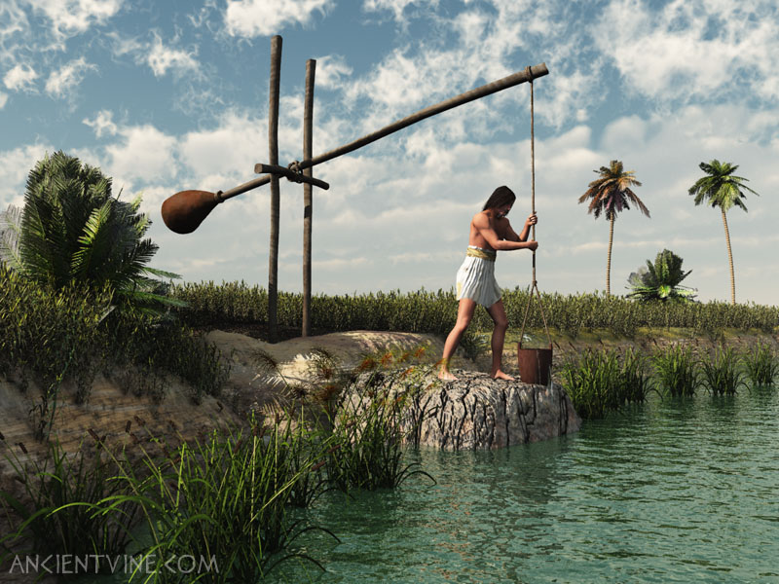
FOV wednesDAY october 11th
A fan-shaped area of silt near where a river flows into the sea is called a _____.
Delta
Bank
Dam
Levee
A bucket attached to a long pole used to transfer river water to storage basins is called a ____.
A. papyrus
b. Shadoof
c. Water Can
d. pool

Slide 5
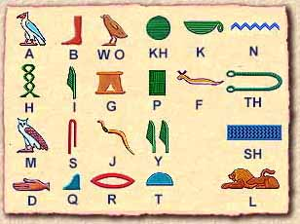
FOV thursDAY october 12th
An Egyptian writing system made up of pictures and sound symbols is called ____.
Theocracy
Dynasty
Hieroglyphics
Cuneiform
A plant that grows wild along the nile river used by Egyptians to make paper is called ___.
Shadoof
pyramid
Papyrus
wheat

Slide 6
FOV Friday October 13th
Hawktoberfest

Slide 7
key
Monday: c & a
Tuesday: d & b
Wednesday: a & b
Thursday: c & c

