Slide 1
FOV Week of Feb. 5-9th
Greece Geography and Review for Quiz 3- Greece Vocabulary

Slide 2
Monday February 5th
1. Identify the continent that Ancient Greece is located in. (Use textbook maps)
A. Asia B. Africa
C. Europe D. North America
2. Identify the major body of water located south of Greece.
A. Ionian Sea B. Black Sea
C. Aegean Sea D. Mediterranean Sea

Slide 3
Tuesday February 6th
1. Looking at the map, choose two physical features that are common in Ancient Greece’s geography.
Note: More than one answer
A. Rivers B. Mountains
C. Peninsulas D. Islands
2. Looking at the geography of Ancient Greece, which occupation (job) do you think was most common for Ancient Greek people?
A. Farmer B. Fisherman

Slide 4
Wednesday February 7th
1. Ancient Greece had origins in two even older civilizations: the Minoan and the Mycenaean Civilizations. On the map, which numbers represent the locations of these civilizations?
A. 2 and 1 B. 5 and 4
C. 3 and 1 D. 4 and 3
2. Identify the major river in Greece.
A. Tiber River B. Aegean Sea
C. Indus River D. No major river

Slide 5
Thursday February 8th- Quiz 3 Review
What is an agora?
A. A Greek city –state
B. Enslaved person in ancient Sparta
C. A story meant to teach a lesson
D. A gathering place; marketplace
2. What is a polis?
A. A Greek city –state
B. Enslaved person in ancient Sparta
C. A story meant to teach a lesson
D. A gathering place; marketplace

Slide 6
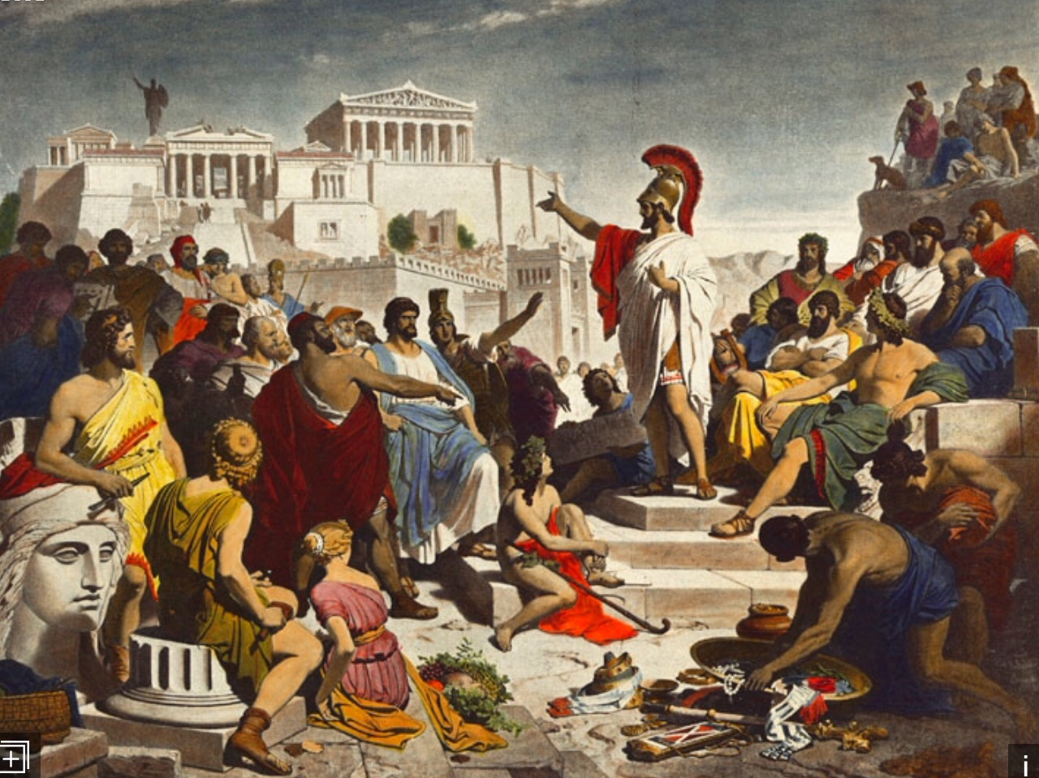
Friday February 9th-Quiz 3 Review
1. Identify a phalanx.
A. A group of armed foot soldiers arranged close together in rows
B. A form of democracy in which all citizens elect officials to govern on their behalf
C. A gathering place; marketplace
D. A Greek city-state
2. Identify a tyrant.
A. A gov’t in which a small group has control
B. A story meant to teach a lesson
C. An absolute ruler unrestrained by law; harsh ruler
D. A piece of land nearly surrounded by water

Slide 7
KEY
Mon.- 1. C 2. D
Tues.- 1. B, C, D 2. B
Weds.- 1. C 2. D
Thurs.- 1. D 2. A
Fri.- 1. A 2. C

