Slide 1
FOV Week of February 12th – 16th
Greece: Vocabulary

Slide 2
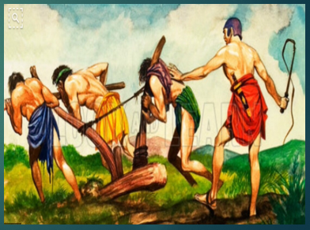
FOV – Monday February 12th
1. Identify a helot
A. Enslaved person in ancient Sparta
B. Foot soldier in ancient Greece
C. Form of ancient Greek writing
D. Story about Greek gods and goddesses
2. Identify an oligarchy
A. Government controlled be a harsh ruler
B. Greek marketplace
C. Government in which a small group has control.
D. Democratic government

Slide 3
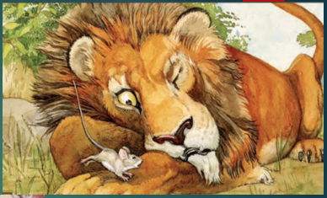
FOV – Tuesday February 13th
1. Identify a fable
A. Story that teaches a lesson
B. Foot soldier in ancient Greece
C. Place where the first Olympics were held
D. Ancient Greek irrigation process
2. Identify an direct democracy
A. Government controlled be a harsh ruler
B. Greek amphitheater
C. Bucket in ancient Greece used to carry olive oil
D. Form of democracy in which citizens can participate firsthand in the decision making process.

Slide 4
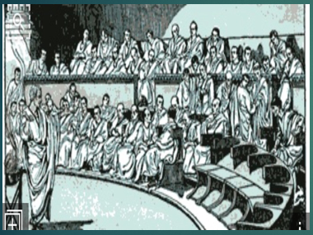
FOV – Wednesday February 14th
1. Identify a myth
A. Ancient Greek religion
B. A temple where ancient Greeks worshipped
C. Traditional story that explains the practices or beliefs of a people or something in the natural world
D. First Greek alphabet
2. Identify a representative democracy
A. Ancient Greek bread
B. Form of democracy in which citizens elect officials to govern on their behalf.
C. Government controlled by a harsh ruler.
D. Greek slave and soldier

Slide 5
FOV – Thursday February 15th
Study for your FOV Quiz!

Slide 6
FOV – Friday February 16th

Slide 7
FOV – Key
Monday: A and C
Tuesday: A and D
Wednesday: C and B
Friday:

