Slide 1
FOV Week of March 5th – 9th
6.56 – Describe the myths and stories of ancient Greece
6.58 – Explain why Greek city-states created the tradition of athletic competitions
6.54 – Explain the rise of Alexander the Great
Vocabulary – Ancient Rome

Slide 2
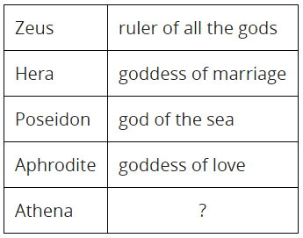
FOV – Monday March 5th
Which of these gods is described in the box to the right?
Re
Jupiter
Anu
Zeus
Which of the following belongs in the box (to the right) with the question mark?
goddess of forests
goddess of music
goddess of wisdom
goddess of grain

Slide 3
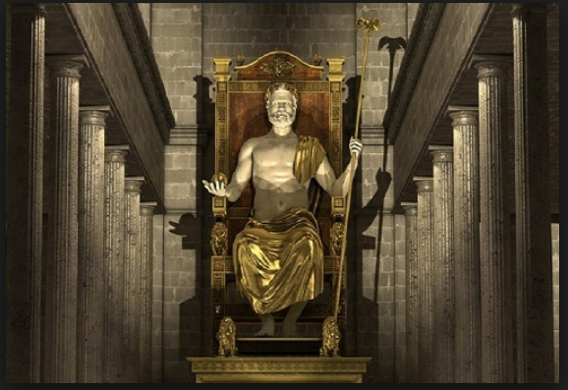
FOV – Tuesday March 6th
The original ancient Olympic Games were held
to honor the goddess Aphrodite.
for the greater glory of the god Zeus.
to appease the god Poseidon, king of the sea.
tor the god Ares to make the people strong in war.
What type of event was the only event in the first Olympics?
It was a 200 meter sprint
It was a marathon race
It was a chariot race
It was a wrestling event

Slide 4
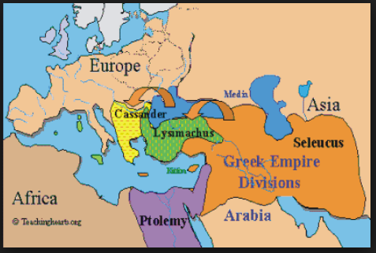
FOV – Wednesday March 7th
What was Alexander the Great best known for?
Being a great poet
Being a mathematician
Being a military genius and commander
Being a philosopher and thinker
What happened to Alexander’s Greek empire after his death?
It fell into the hands of the Romans
The Egyptians took it over
It was divided up between his top generals
His mother the queen took over

Slide 5
FOV – Thursday March 8th
Early Dismissal

Slide 6
FOV – Friday March 9th
Gladiator
A Roman marketplace
In ancient Rome, a person who fought people or animals for public entertainment
A Roman government official
An indirect democracy
2. Plebian
Place of worship in ancient Rome
Military battalion arranged in rows to march into battle
Roman city-state
Ordinary citizen in ancient Rome

Slide 7
FOV - Key
Monday: D and C
Tuesday: B and A
Wednesday: C and C
Friday: B and D

