Slide 1
FOV week of Nov.13-17th
Israel

Slide 2
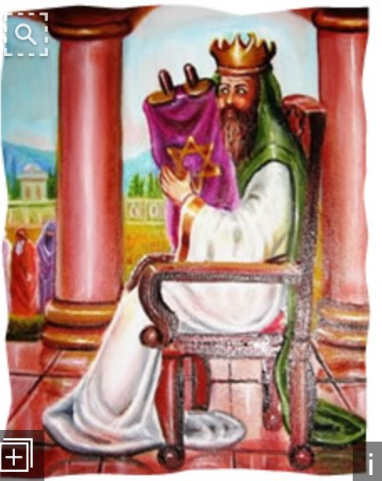
Monday Nov. 13th
1. Identify the continent Israel is located in.
A. Africa B. Asia
C. Europe D. South America
2. Which monotheistic religion is most associated with Israel?
A. Hinduism B. Buddhism
C. Judaism D. Christianity

Slide 3
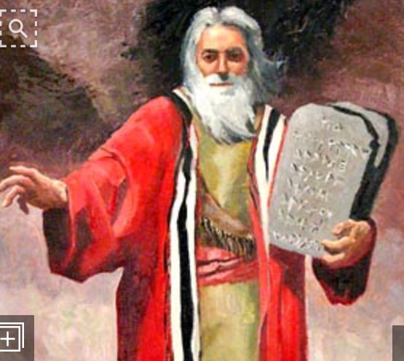
Tuesday nov. 14th
1. Identify the holy books of Judaism. (Choose as many as apply).
A. Quran
B. Old Testament/ Hebrew Bible
C. Torah
D. Vedas
2. Who is the founder of Judaism?
A. Abraham B. Jesus
C. Mohammad D. Aryans

Slide 4
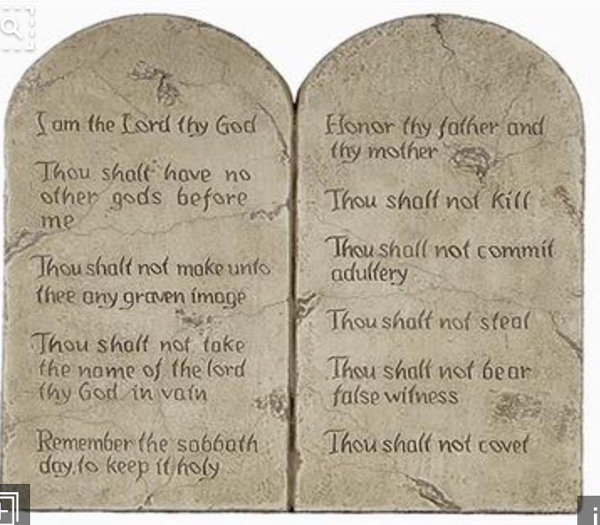
Wednesday nov. 15th
1. What was the departure of the Israelites out of slavery in Egypt called?
A. Torah B. Commandments
C. Covenant D. Exodus
2. What were rules that God wanted the Israelites to follow called?
A. Tribe B. Commandments
C. prophet D. Monotheism

Slide 5
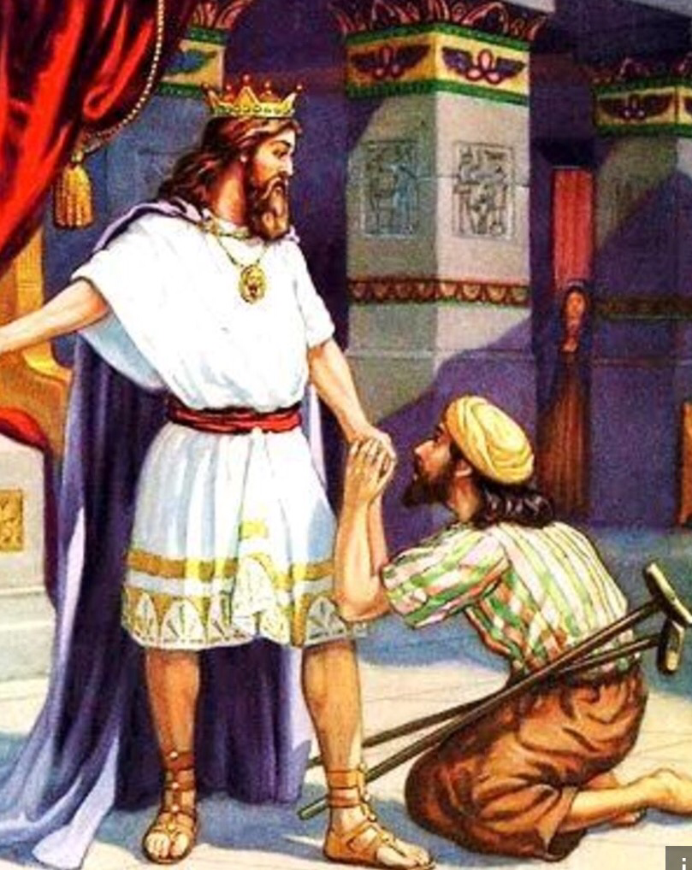
Thursday nov. 16th
Which Canaanite group created the first alphabet (with sound/symbol relationships)?
A. Phoenicians
B. Mesopotamians
C. Egyptians
D. Chaldeans
2. Which king united the Israelite tribes?
A. King Saul B. King David
C. King Moses D. King Abraham

Slide 6
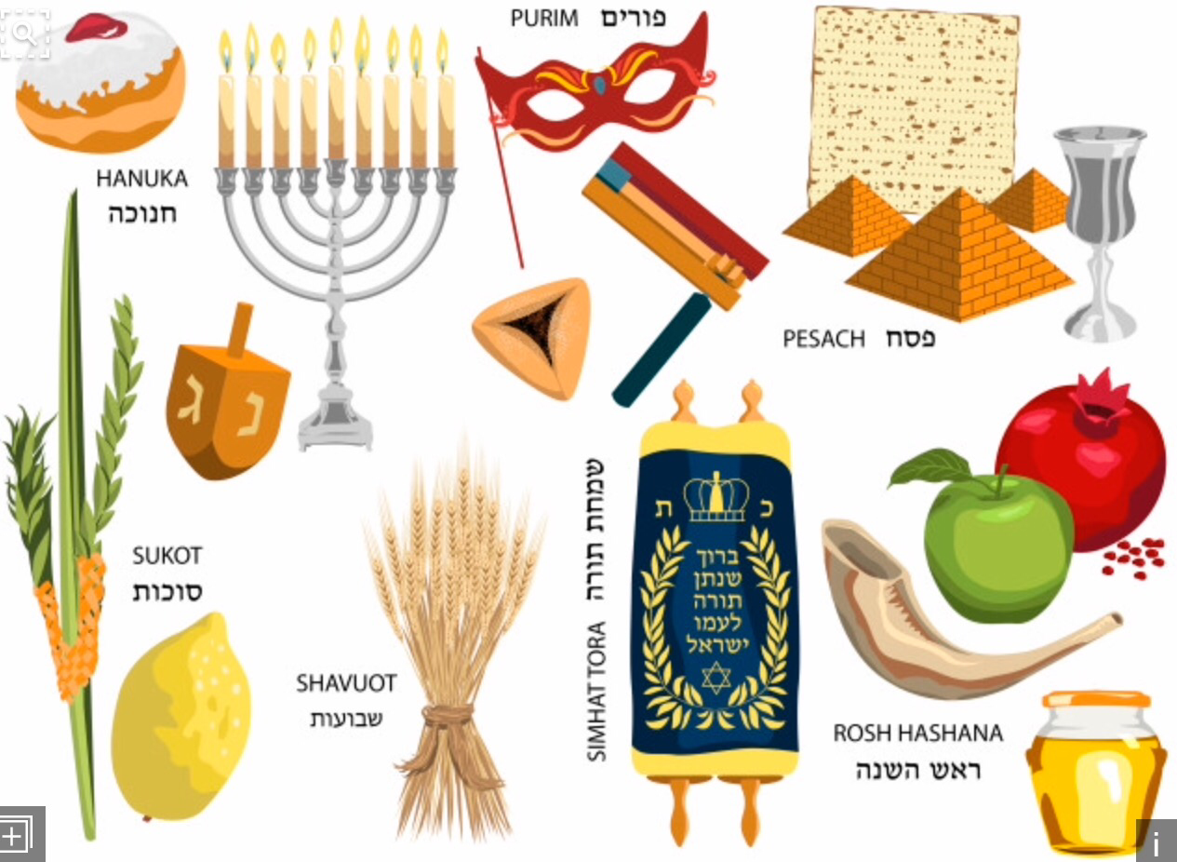
Friday nov. 17th
1. What is the Jewish place of worship called?
A. Church B. Mosque
C. Synagogue
2. Identify all Jewish holidays below. (Choose as many as apply)
A. Christmas B. Passover
C.Yom Kippur D.Rosh Hashanah

Slide 7
Friday Nov. 17th- Exceptional 18
1. If a test asks you to “Interpret”, they want you to _______.
A. Back up with details
B. quote
C. Make sense of
D. give me the short version
2. If a test asks you to “develop”, they want you to _____.
A. Grow or advance over time
B. tell what will happen next
C. Tell all about it
D. judge

Slide 8
KEY
Mon.- 1. B 2. C
Tues.- 1. B, C 2. A
Weds.- 1. D 2. B
Thurs.- 1. A 2. B
Fri.- 1. C 2. B, C, D
Fri. (Exceptional 18) 1. C 2. A

